Slide 1
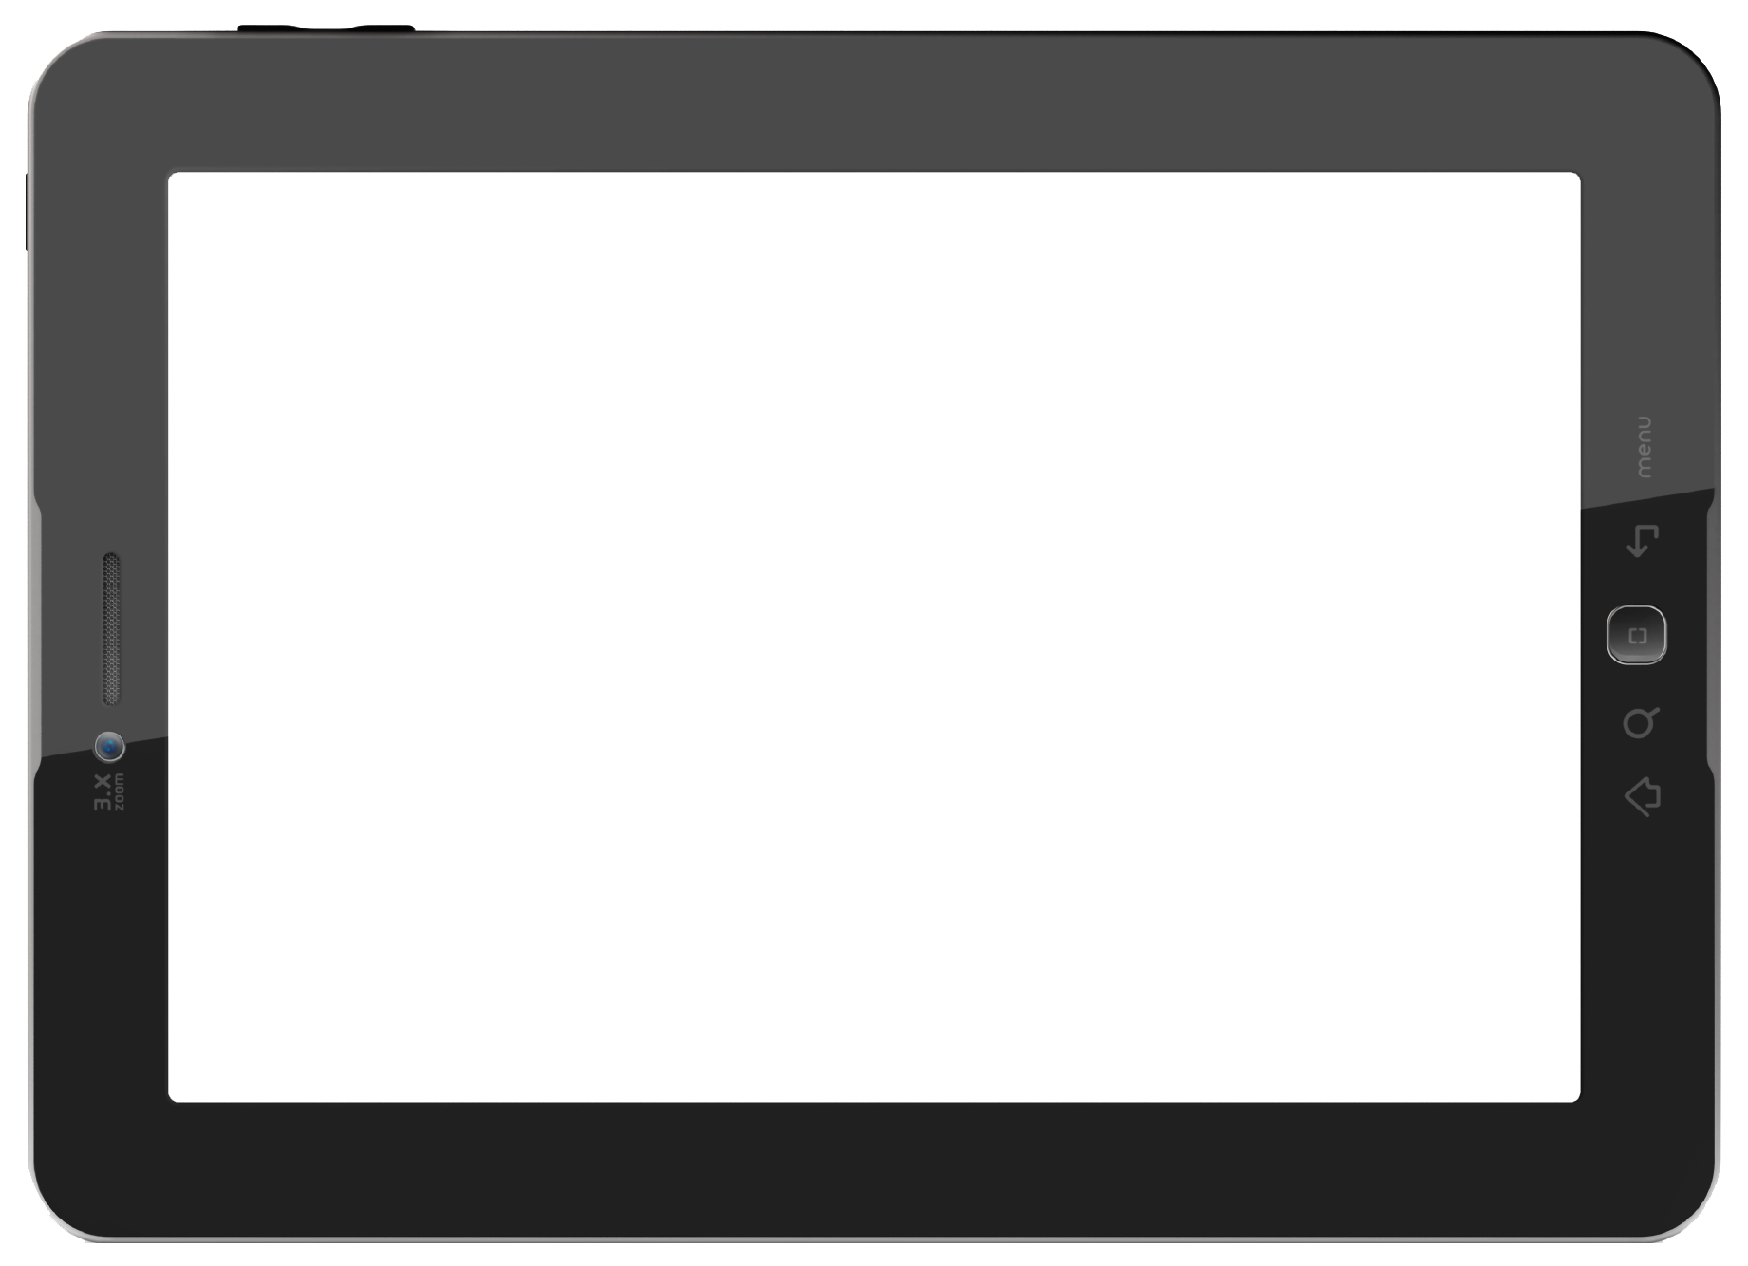



IOT – Basics
Session 2
By
Sindhu Velayudham
PhD Research Scholar
IIITT
Email- svelayudham@iiitt.ac.in

Slide 2
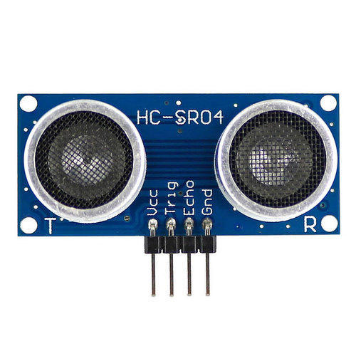
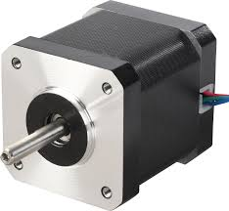
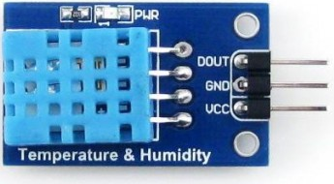
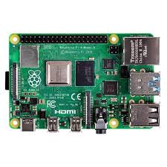
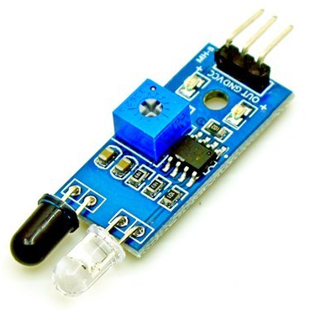
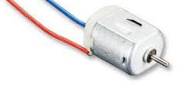
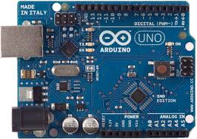
OUTLINE
Sensors
Actuators
Microcontroller (Arduino)
Microprocessor (Raspberry Pi)

Slide 3
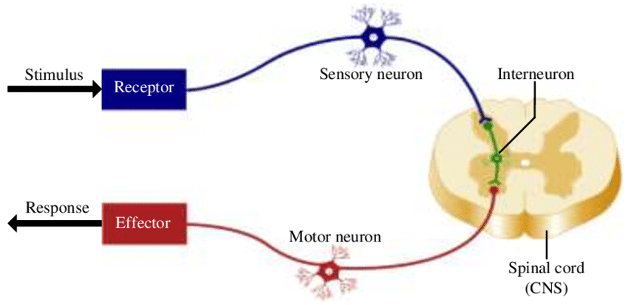

Slide 4
Sensor
A sensor detects / measures a physical property

Slide 5

Fingerprint sensor
Ambient light sensor
Proximity sensor
Gyroscope
Accelerometer
Sound sensor
Temperature sensor
Barometer
Magnetic sensor
Orientation sensor
IR sensor (Redmi)
Pedometer and heart rate sensor
NFC (Near Field Communication) sensor

Slide 6
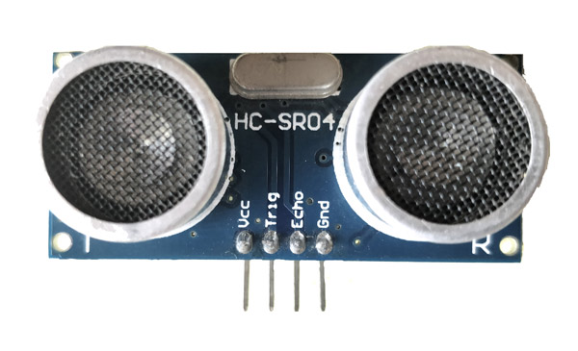

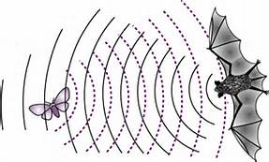
Ultrasonic Sensor

Slide 7
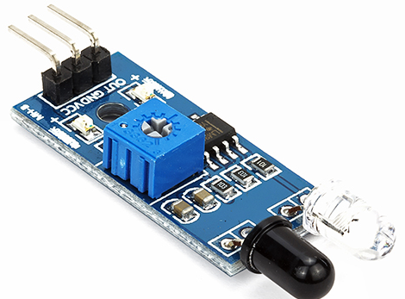
IR Sensor

Slide 8
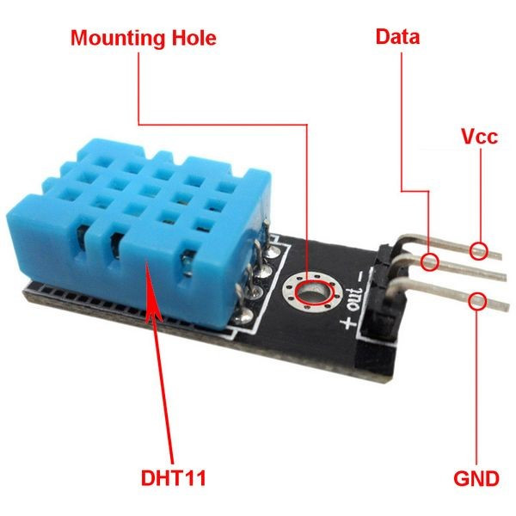
Humidity Sensor

Slide 9


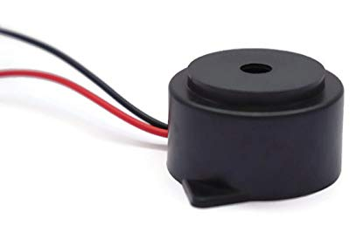
Actuator
An actuator is a device that moves or controls some mechanism

Slide 10
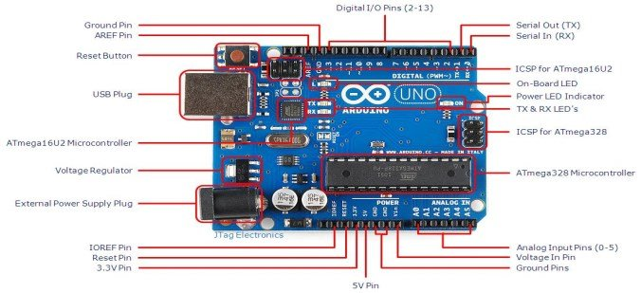

Slide 11
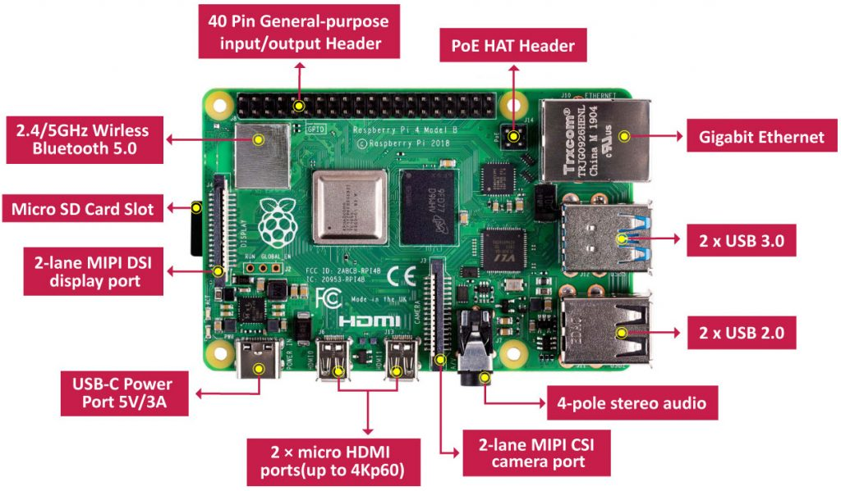

Slide 12
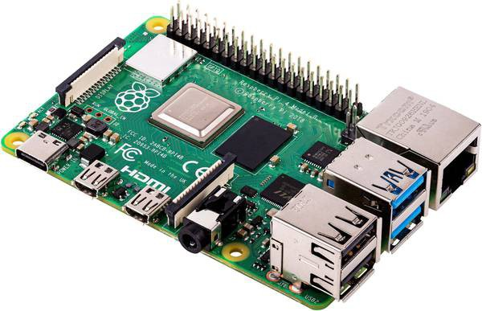

Slide 13


Slide 14


Arduino | Raspberry Pi
Microcontroller ATMega328P AVR Family | Microprocessor (Single Board computer) ARM Family
Only one program a time | Multiple programs
Simple to interface with sensors | Need packages and libraries
Low cost | Expensive
Need proper hardware and code to connect to the internet | Easy to access the internet (Ethernet)
Onboard storage | SD Card
Plug and Play | Need proper procedure else may corrupt the file
C, C++ | C,C++, Python, Ruby
One USB | 4 USB
No OS | Linux based OS

Slide 15


